Slide 1

Big Mart Data Analysis Presentation
How Can Big Mart Increasing Sales
Clem Mbote

Slide 2
Using Random Forest Regression Model, we will answer the question:
Can Big Mart Increase Sales?
Categorical Columns are:
•Product ID
•Low Fat or Regular
•Product Category
•Store ID
•Year Opened (Treating Year Opened as a Category)
•Grocery Store or Supermarket
•Size of Store
Numeric Columns are:
•Weight
•Visibility
•Product List Price
•Item Outlet Sales

Slide 3
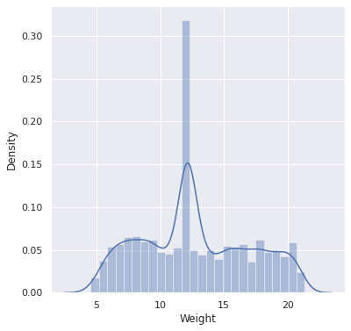
Product Weight
30% of all products weigh around 12lbs.
Question:
The heaviness of a product shouldn’t be a factor when a customer is deciding on their purchase. Is this the case with Big Mart?

Slide 4
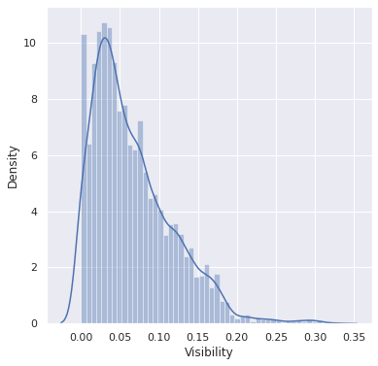
Product Visibility - Are Big Mart products displayed effectively
Big Mart products have an average visibility score of 0.06.
Question:
Should Big Mart redesign their store floors so that more products are visible to the customers?

Slide 5
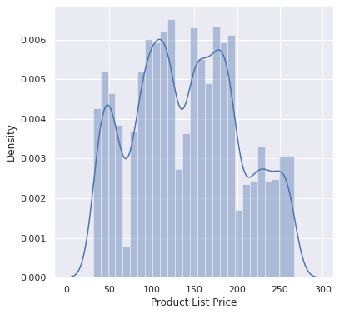
Product List Price - Are Big Mart products priced effectively
Most list prices are falling into four buckets $50,$100, $175, and $225
Question:
If Big Mart increased prices, one would expect sales to increase. Will it?

Slide 6
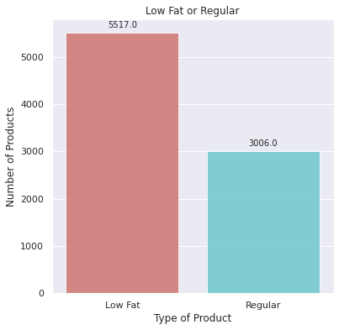
Go 100% Healthy????
Nearly 2/3 of the products sold are low fat products
Question:
Should Big Mart consider becoming a 100% Health Food company?

Slide 7
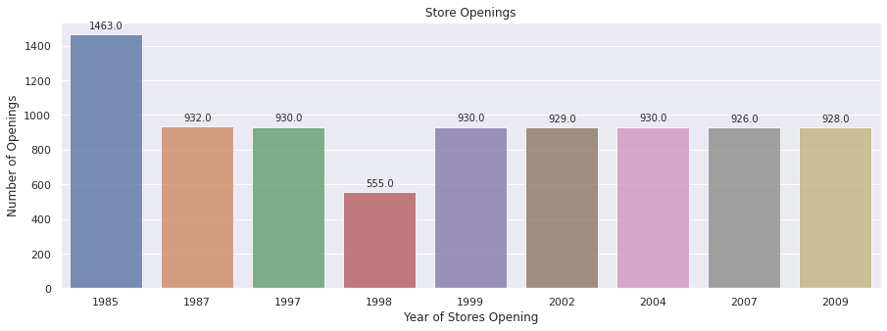
Store Openings
When Big Mart decides to open stores in any given year, 930 seems to be the target number of stores they generally open.
Question:
Should Big Mart open a higher number of stores the next time they expand.

Slide 8
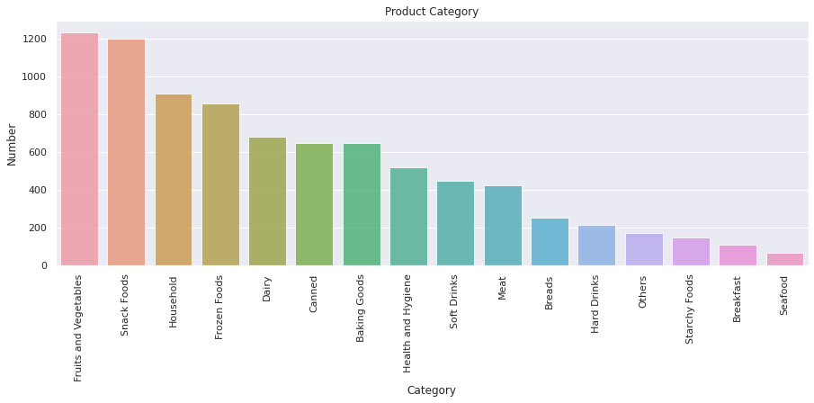
Product Food Types
Should Big Mart become a specialized store focusing on fewer product categories?
Approximately 50% of all products sold fall within 4 categories
Fruits and Vegetables 14.4%
Snack Foods 14.1%
Household 10.7%
Frozen Foods 10.0%

Slide 9
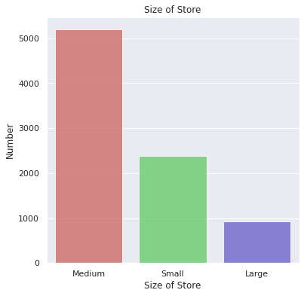
Size of Stores
Nearly 60% of stores are 'Medium Size' stores
Question:
Should Big Mart consider remodeling their ‘Medium Size’ stores to ‘Large Size’ stores?

Slide 10
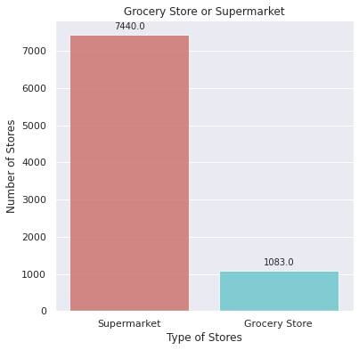
Type of Stores
Nearly 90% of Big Mart stores are 'Supermarket' stores
Question:
Should Big Mart consider a becoming a full-fledge Supermarket chain?

Slide 11
Random Forest Model R2 Results
R-squared represents the proportion of the variance for a dependent variable that's explained by an independent variable
R2 value using Training data is 94%
The model does well on the train data
R2 value using Testing data is 56%
The model does adequate on the test data

Slide 12
Random Forest Model Error Results
Tells us how far away our avg ‘Item Outlet Sales’ is from our actual data
Baseline Error on Training data is $2,095.84
Error on Testing data is $762,57
The model reduces the error estimation by $1,333.27, a nearly 64% improvement from the baseline, which depending on the variable and the problem being solved, could represent millions of dollars in sales to Big Mart.

Slide 13
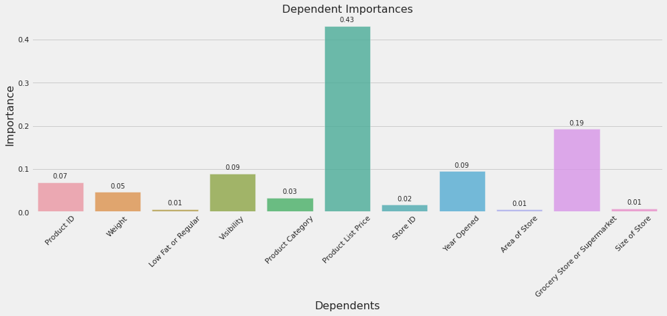
Which variables have the most potential impact to Big Mart sales
Product List Price is the variable that impacts Big Mart sales the most - 43%
Type of Store is the 2nd Highest - 19%
Visibility - 9%
Year Opened - 9%
All Others - 20%

Slide 14
What should Big Mart do to increase sales?
Weight - .05
The heaviness of a product shouldn’t be a factor when a customer is deciding on their purchase, and it shouldn’t be for Big Mart
Visibility - .09
Should Big Mart redesign their store floors so that more products are visible to the customers? - Not the most bang for their buck
Product List Price - .43
Big Mart should definitely increase their prices as it would be an effect way to raise sales

Slide 15
What should Big Mart do to increase sales?
Low Fat or Regular - .01
Should Big Mart consider becoming a 100% Health Food company? - Absolutely NOT.
Year Open - .09
Should Big Mart open a higher number of stores the next time expand. - They should consider opening more than the typical number of stores that they normally do when their next expansion year arrives
Product Category - .03
Should Big Mart become a specialized store focusing on fewer product categories? - No, becoming a specialized food company would have very little impact in increasing sales

Slide 16
What should Big Mart do to increase sales?
Size of Store - .01
Should Big Mart consider remodeling their ‘Medium Size’ stores to ‘Large Size’ stores? - No, it’s nas been shown that the size of the store has minimal impact of sales.
Type of Store- .19
Should Big Mart consider a becoming a full-fledge Supermarket chain? Big Mart may want to look at changing the 10% grocery stores that they own into Supermarkets.

